Slide 1
CSS Box Model

Slide 2
AGENDA
Demo of this week’s project
Writing Semantic HTML5
Block Level Elements / Inline Level Elements
Styling with CSS
Box Model : border-box
CSS Debugging in DevTools
CSS Reset & Normalization
Other topics

Slide 3
2. Writing Semantic HTML

Slide 4
HTML Syntax

Slide 5
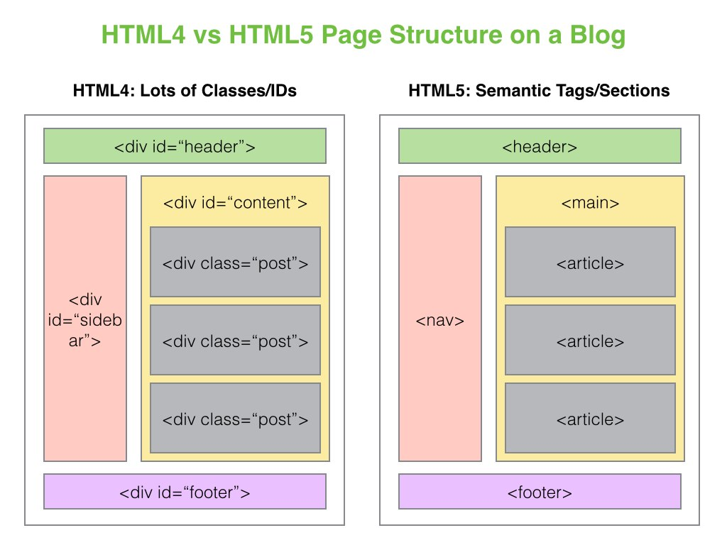
Semantic HTML5

Slide 6
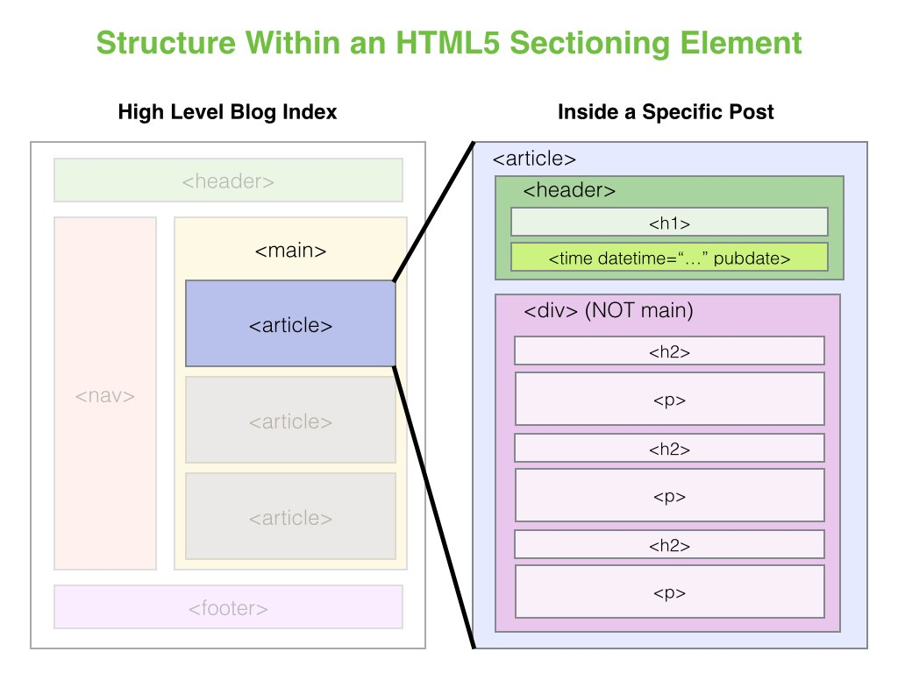
Semantic HTML5

Slide 7
3. Block Level Elements / Inline Level Elements

Slide 8
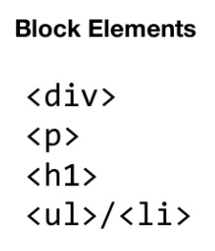
Block Level Elements

Slide 9
4. Styling with CSS

Slide 10

CSS
CSS stands for Cascading Style Sheets
Used to control appearance of markup languages like HTML
Must learn for building front ends of web applications
Analogy : construct buildings with HTML & decorate them with CSS

Slide 11
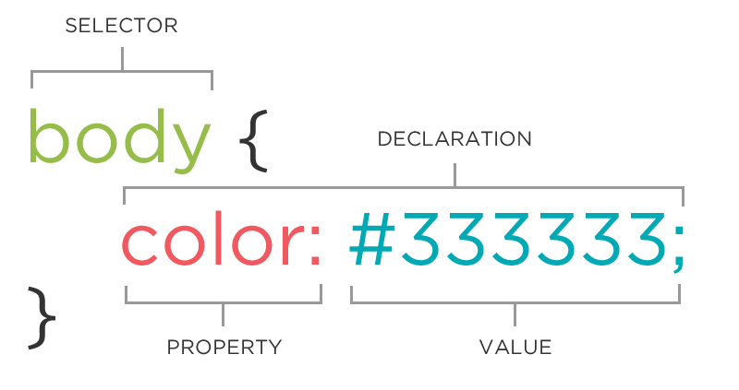
Creating CSS rules
Rules : define a selector and a declaration block
Selector : indicates element(s) subject to styling
Declaration block : instructions for browser for formatting element(s)
Declaration parts: property and value
Better readability
Indentation
Spacing
One declaration per line (;)

Slide 12
WAYS OF APPLYING CSS
Use inline code directly in an HTML element (higher priority)
Use style block inside a web page
Use an external style sheet with a .css extension
Styles can be combined (even from different sources)

Slide 13
5. Box Model

Slide 14
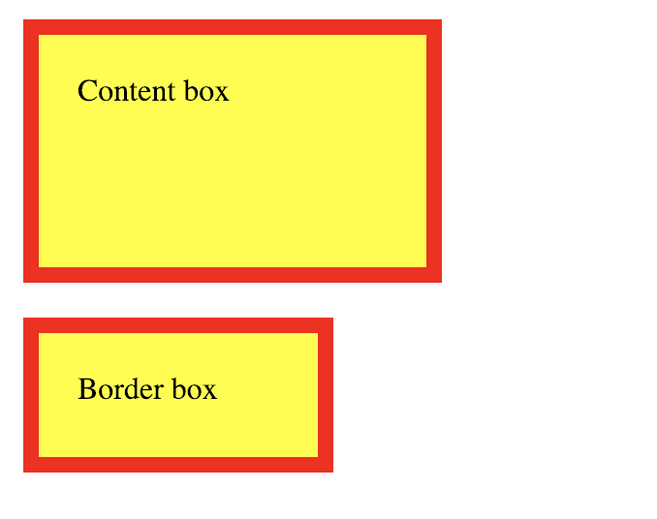
Box Model

Slide 15
6. CSS Debugging in Dev Tools

Slide 16
7. CSS Reset & Normalization

Slide 17
Normalizing CSS

Slide 18
8. Other Topics

Slide 19
Other Topics
Bootstrap (CSS/UI grid frameworks)
CSS Preprocessors (SCSS)
Flexbox (CSS3 web layout model)

